Slide 1

Consonant Development In Children with Cleft lip/palate
Meg Rosales

Slide 2
Background
Before statistics, I was a speech-language pathologist (speech therapist if you’re more familiar with that term).
I worked in the Phonology and Cleft Palate Lab under Dr. Kathy Chapman in the Department of Communication Sciences and Disorders for five years.
The data I am using comes from a longitudinal study done by Dr. Chapman and colleagues many years ago (1990s) on speech sound development in children with cleft lip/palate (still plenty of data to analyze)
I used to clean this data for work. Thought it might be nice to use some of my cool new statistics tools to analyze it.

Slide 3
Motivation: Why should we care?
Literature is still developing in this field compared to other fields (newer field, focus on clinical practice rather than research)
Understanding the differences in how children with cleft lip/palate develop sounds compared to their non-cleft peers can better inform speech therapy goals, resulting in more effective speech treatment for these children.

Slide 4
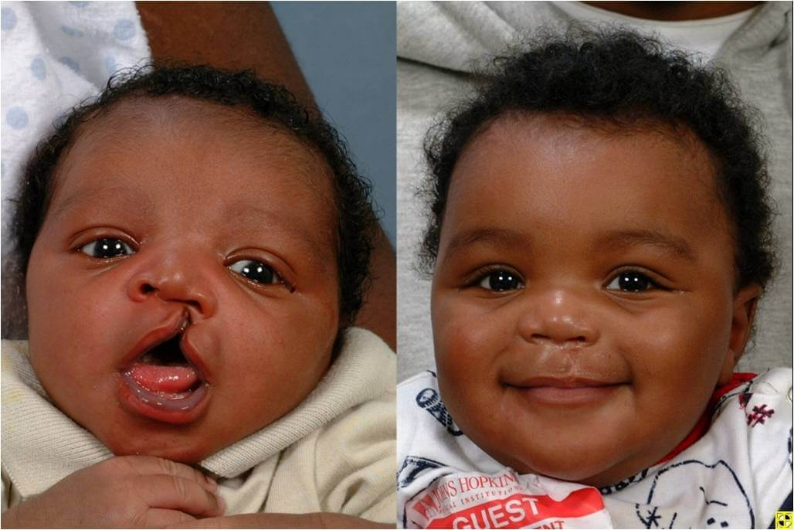
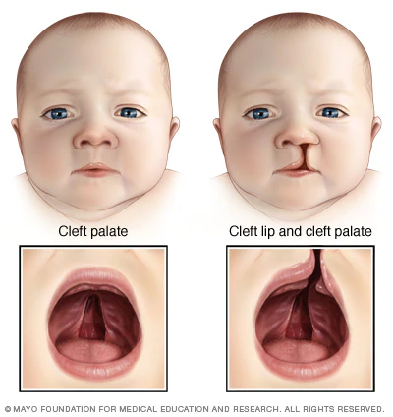
What is cleft lip/palate?
One or two-sided split in the lip or the roof of the mouth due to facial tissue not fusing properly when a baby is developing
Commonly occurs as a birth defect by itself
Often syndromic
Typically corrected with surgery
Affects production of speech sounds and thus, speech development in children
Image sources:
(Top)
https://www.hopkinsmedicine.org/otolaryngology/specialty_areas/facial-plastic-reconstructive/reconstructive/cleft-palate.html
(Side)
https://www.mayoclinic.org/diseases-conditions/cleft-palate/symptoms-causes/syc-20370985

Slide 5
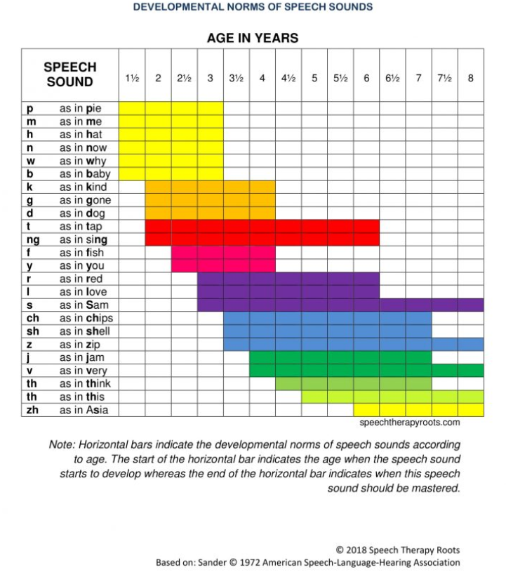
Speech sound development: A crash course
Consonant: sound produced by blocking the air somewhere in your speech mechanism
True consonant: consonants where the airflow is blocked/disrupted somewhere in the mouth (consonants that aren’t glottals or glides, /h/, /j/, /w/, or / ʔ/ , (Stoel-Gammon, 1989)).
For consonants like /h/, /j/, /w/, mouth/tongue/throat moves but doesn’t really disrupt the airflow
/ ʔ/ is the catch-in-throat sound (e.g., “uh-oh”)
Consonant inventory: set of consonants a kid is able to produce consistently
Why are we looking at consonants?
Early developing
Really important for understanding what a kid is saying
Impacted by physical difficulties caused by cleft lip/palate
This is what we’re going to be targeting in therapy
https://speechtherapyroots.com/product/speech-sound-development-chart/

Slide 6
Consonant development in kids with cleft: The literature
Cleft lip and palate is associated with delayed speech in young children
Children with cleft lip/palate tend to favor sounds that don’t require them to close the palate (Hutters, Bau,& Brøndsted, (2001))
Children with cleft lip/palate demonstrated more speech errors than noncleft peers
(Chapman & Hardin, 1992): Study of two-year olds
(Lohmander & Persson, 2008): Longitudinal study of 3, 5, and 7 year olds
Children with cleft lip/palate have smaller consonant inventories and lower accuracy of production but similar development rate of speech (Chapman, Hardin-Jones, & Halter, 2003)
I’m using a subset of the data from this study. They compared measures including the ones I’m using at each point using t-tests.
Speech delays persist even after the palate is surgically closed (Scherer, Williams, & Proctor-Williams, 2008)

Slide 7
Research questions
Is there any difference in size of consonant inventory over time for a kid with a cleft vs. a non-cleft peer?
Is there any difference in accuracy of consonant production over time for a kid with a cleft vs. a non-cleft peer?
Hypothesis: Poorer performance on all measures for a kid with cleft, rate over time of speech sound development should not differ for a kid with cleft vs. one without cleft assuming no other non-related speech/cognition issues are present

Slide 8
The data
Longitudinal data gathered for one site (study occurred over multiple sites, using subset of data)
Participants: 39 children with and without CLP
27 children with CLP, 12 without CLP
Criteria: “complete cleft of the hard and soft palate¡ cleft lip, non-syndromic, normal cognitive functioning, no multiple congenital anomalies, neurological impairment or sensorineural hearing loss” (Chapman, 2004)
Timepoints: 9, 13, 17, 21, 27, 33, 39 months of age
Several of the kids missed at least one, maybe a few time points – data appear to be missing at random (MAR)
(Need formal analysis of this? Visually inspected)
Study design: Natural speech sample was taken during caregiver/examiner play with the child. Sample was then transcribed by trained listeners and entered into software that calculates consonant inventory data and percent correct for different classes of sounds/sounds over the entire sample.
Outcome variables:
Size of consonant inventory: Number of consonants kid is able to produce at a given age
Number of true consonants in inventory: Number of true consonants kid is able to produce at a given age
Percentage correct stop consonants produced: Percentage of stop consonants kid is produced correctly (number of stops produced correctly/total number of stops produced in sample)

Slide 9
Approach
Is there any difference in size of consonant inventory over time for kids with cleft vs. their non-cleft peers?
Consonant inventory: Linear mixed effects model
Outcome: concount (continuous) = Size of child's consonant inventory at age (should I be using Poisson instead? Could think of as count)
Fixed effects: Cleft (binary) = Whether child has a cleft (1) or not (0), Months (factor) = Because only a few time points and it looked like slope might differ between time points
Random effect: Subject (want to make inference generalizable outside this study, interpret at the subject level)
True consonant inventory: Linear mixed effects model
Outcome: tccount (continuous) = Size of true consonant inventory at age
Fixed effects: Cleft (binary) = Whether child has a cleft (1) or not (0), Months (factor)
Random effect: Subject
Is there any difference in accuracy of consonant production over time for kids with cleft vs. their non-cleft peers?
Percent total correct stop consonants : Linear mixed effects model
Outcome: tcorplos (continuous) = Percent of stop consonants correctly produced during child’s speech sample at age
Fixed effect: Cleft (binary) = Whether child has a cleft (1) or not (0), Months (factor)
Random effect: Subject
Only examine from 17-39 months because children don’t produce enough stop consonants in order to measure this before 17 months

Slide 10
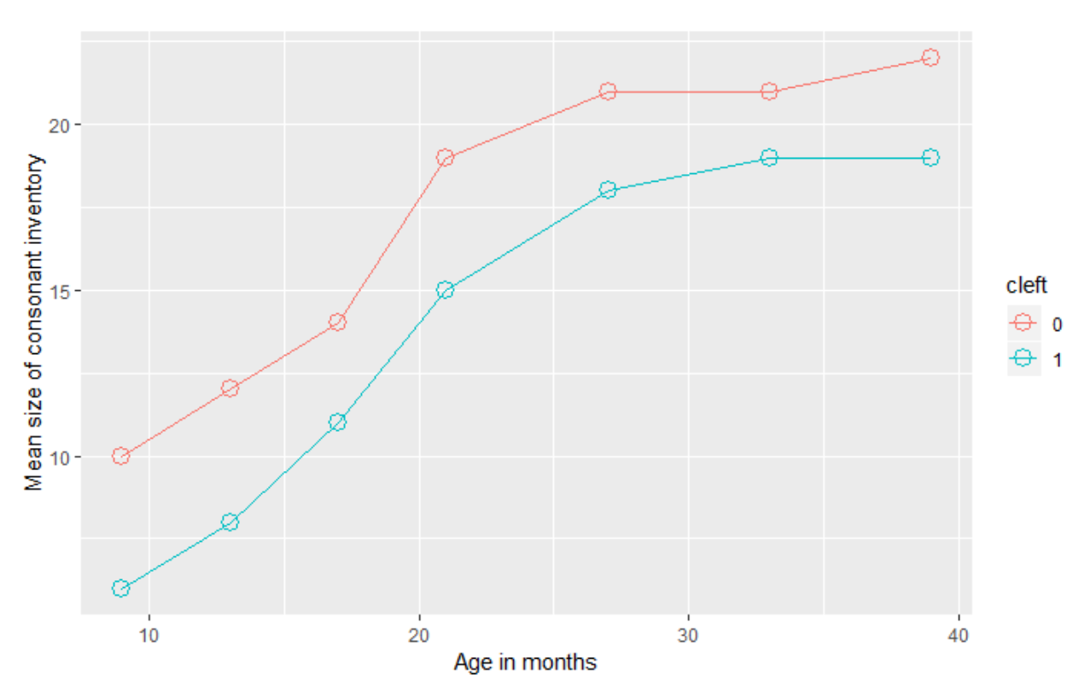
Results: Consonant Inventory
Kids with CLP start and end with smaller mean size of consonant inventory
Developmental trend seems to be about the same for both groups – increase in size of inventory for each ~4 mo. interval
Little if any group x time interaction

Slide 11
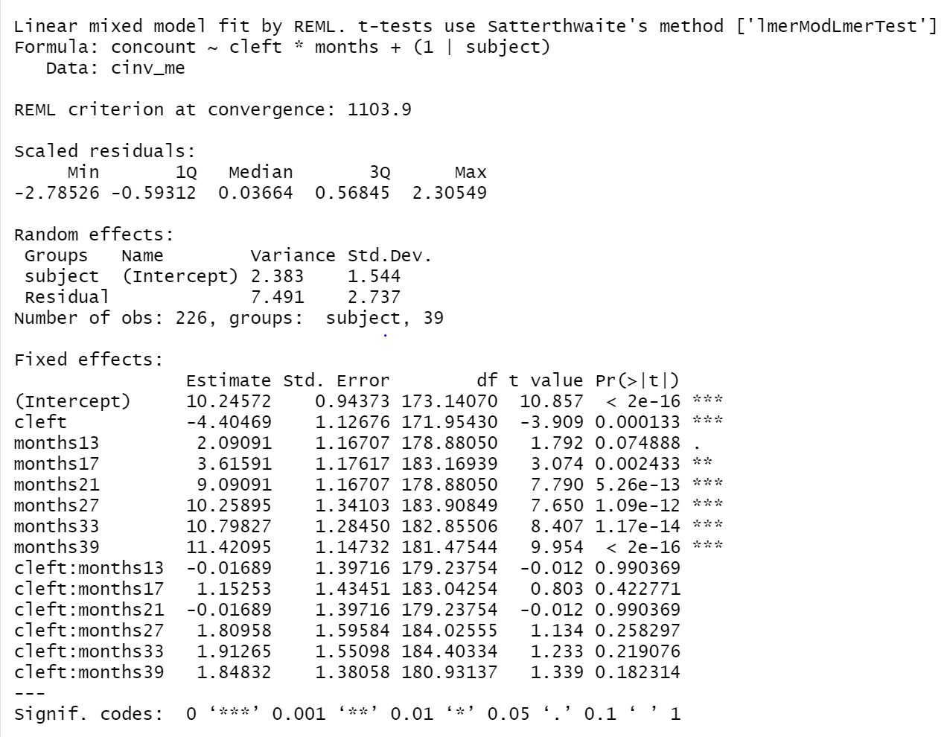
Results: Consonant Inventory
Child w/o CLP starts at ~ 10 consonants; child w/ CLP starts ~ 6 consonants
Significant difference b/w kid w/ CLP and kid w/o CLP (p < .001)
Significant increases in number of consonants for all sessions from 17 – 39 months
13 months is borderline (2 consonants, p = 0.07); would consider this clinically relevant though not technically significant at p < 0.05
No group x time interaction – develop consonants at the same rate

Slide 12
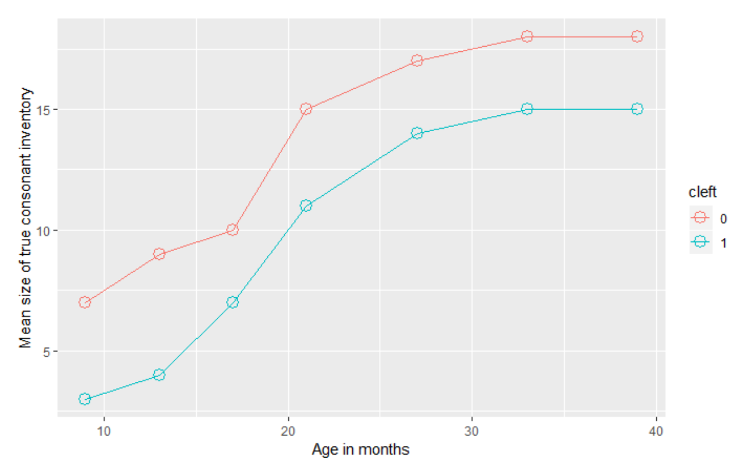
Results: True consonants
Kids with CLP start and end with fewer true consonants
Developmental trend seems to be about the same for both groups – increase in number of true consonants for each ~4 mo. interval
Little if any group x time interaction

Slide 13
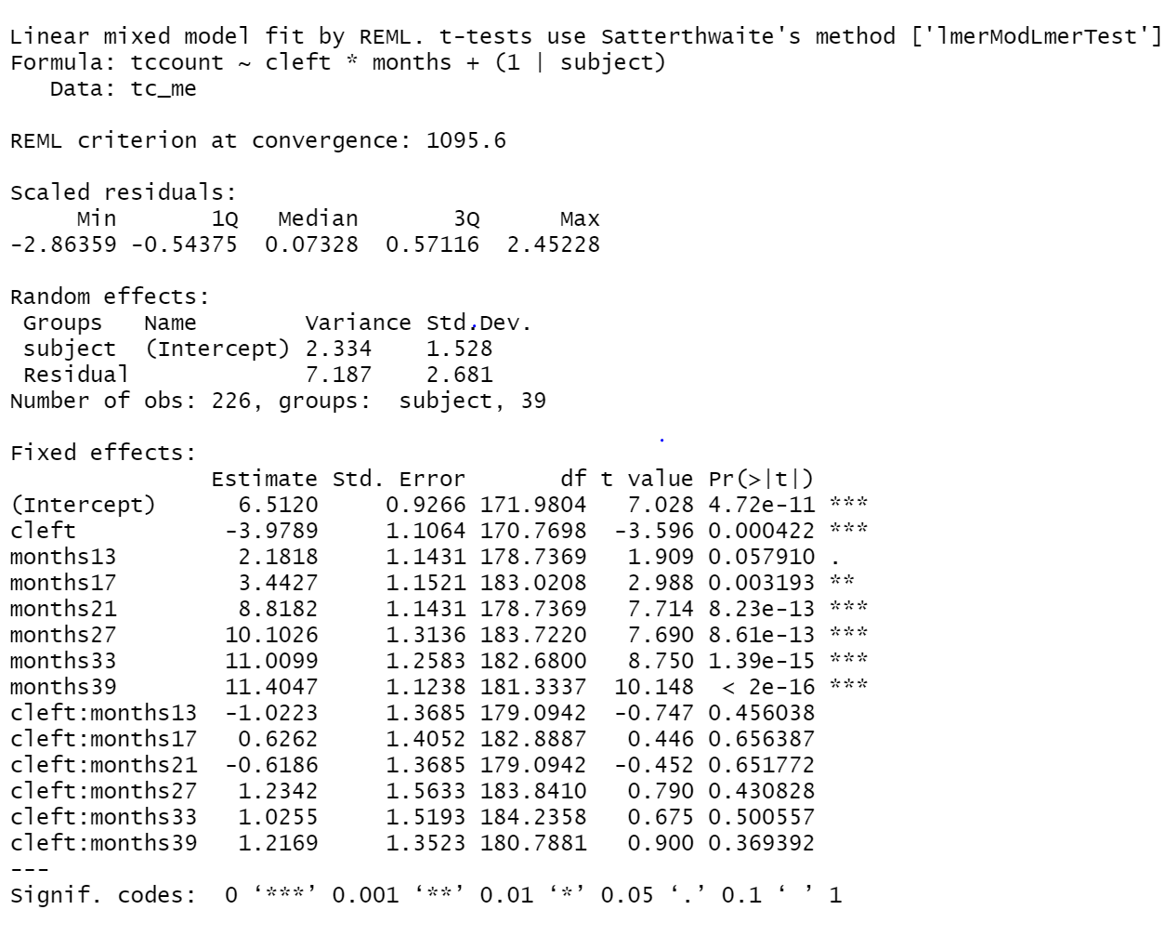
Results: True consonants
Child w/o CLP starts at ~ 7 true consonants; child w/ CLP starts at ~ 3 consonants
Significant difference b/w kid w/ CLP and kid w/o CLP (p < .001)
Significant increases in number of consonants for all sessions from 17 – 39 months
13 months is borderline again (2 consonants, p = 0.06); would consider this clinically relevant though not technically significant at p < 0.05
No group x time interaction – develop consonants at the same rate

Slide 14
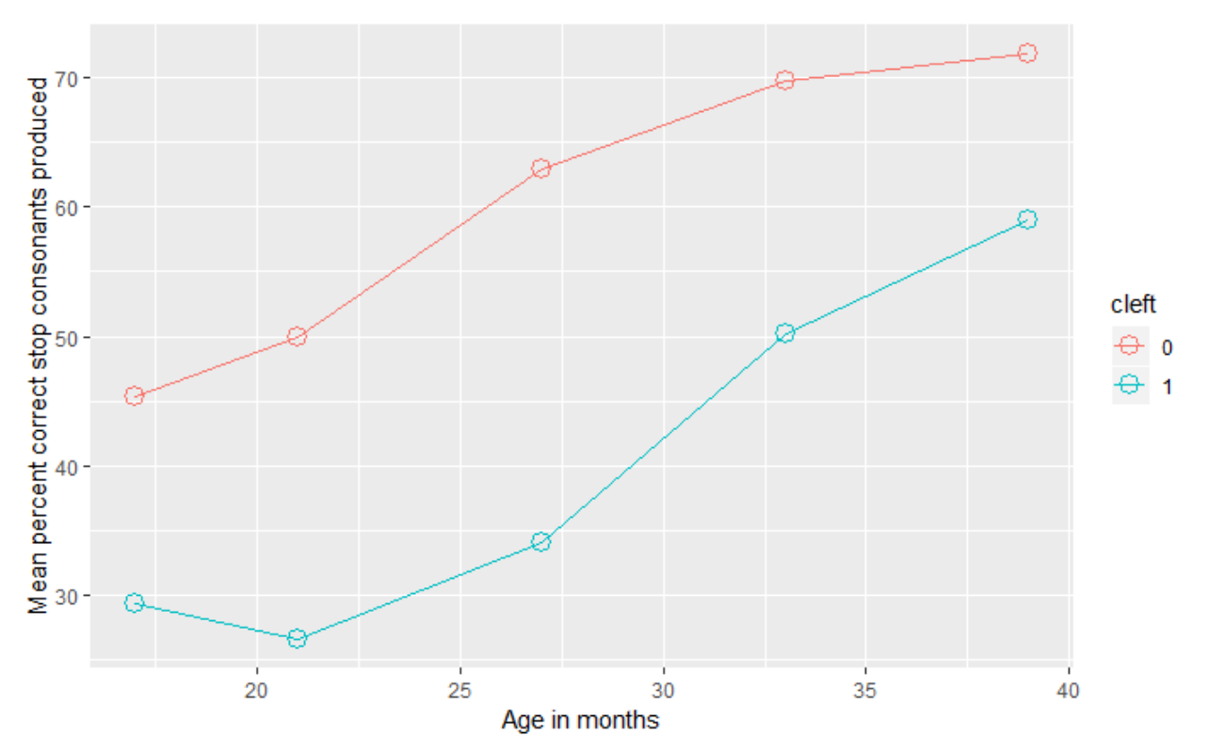
Results: Percent total correct stop consonants
Kids with CLP start and end with lower accuracy for stop consonant production
Developmental trend seems to be about the same for both groups – increase in size of inventory for each ~4 mo. interval
Little if any group x time interaction

Slide 15
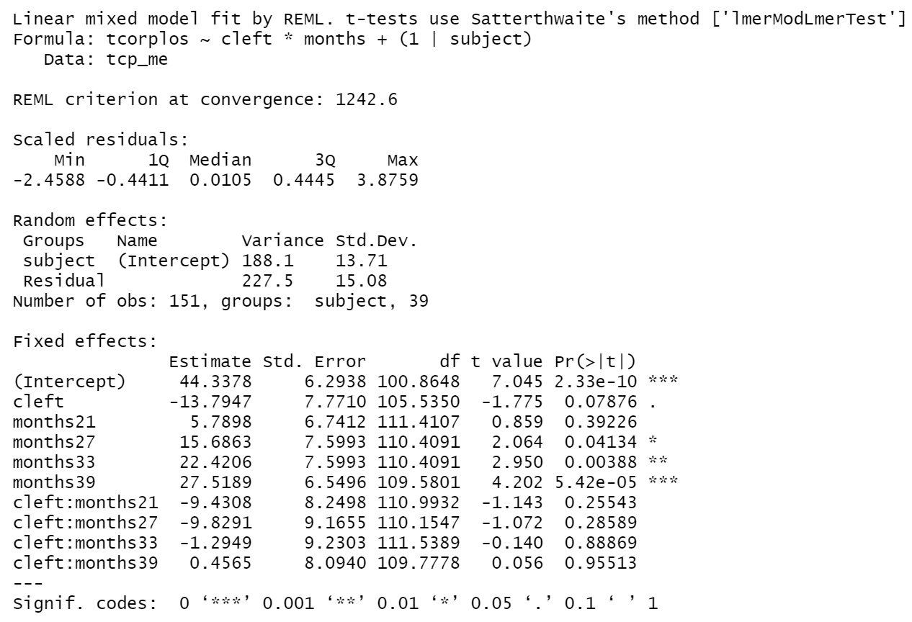
Results: Percent total correct stop consonants
Child w/o CLP starts at 44% accuracy for stop consonants; child w/ CLP starts at 30% accuracy
Difference b/w kid w/ CLP and kid w/o CLP is not technically significant at p <0.05 (p = 0.08), but a 13% difference in accuracy seems clinically significant
Significant increases in stop consonant accuracy for all sessions from 27 – 39 months – big jump from 21 to 27 months
No group x time interaction – accuracy develops at the same rate

Slide 16
Discussion
The data support the earlier hypothesis that children with cleft will have smaller consonant inventories and lower consonant production accuracy than children who don’t have cleft.
Limitations:
Small sample size: lack of power
This isn’t the full dataset
I left the NAs in, but it seems that lmer() removes those cases by default.
Unbalanced sample? – though LMEM should be able to handle this, not sure if there’s a limit though

Slide 17
Conclusions
From ages 9 – 39 months, a child with a cleft starts and ends with fewer consonants in their inventory than a peer without a cleft.
From ages 17 – 39 months, a child with a cleft starts and ends with lower accuracy in consonant production than a peer without a cleft.
Rate of speech sound development is the same for a child with a cleft and a non-cleft peer.
Future directions:
Look at timelines /rates of development/accuracy of production by specific sounds
Stratify by gender

Slide 18
Thank you! Questions?

Slide 19
References
Chapman, K. (2004). Is presurgery and early postsurgery performance related to speech and language outcomes at 3 years of age for children with cleft palate? Clinical Linguistics & Phonetics, 18(4-5), 235-257.
Chapman, K. L., & Hardin, M. A. (1992). Phonetic and phonologic skills of two-year-olds with cleft palate. The Cleft palate-craniofacial journal, 29(5), 435-443.
Chapman, K., Hardin-Jones, M., & Halter, K. (2003). The relationship between early speech and later speech and language performance for children with cleft lip and palate. Clinical Linguistics & Phonetics,17(3), 173-197.
“Cleft lip & cleft palate.” (2020). MayoClinic. https://www.mayoclinic.org/diseases-conditions/cleft-palate/symptoms-causes/syc-20370985
Hutters, B., Bau, A., & Brøndsted, K. (2001). A longitudinal group study of speech development in Danish children born with and without cleft lip and palate. International Journal of Language & Communication Disorders, 36(4), 447-470.
Lohmander, A., & Persson, C. (2008). A longitudinal study of speech production in Swedish children with unilateral cleft lip and palate and two-stage palatal repair. The Cleft Palate-Craniofacial Journal, 45(1), 32-41.
Scherer, N. J., Williams, A. L., & Proctor-Williams, K. (2008). Early and later vocalization skills in children with and without cleft palate. International Journal of Pediatric Otorhinolaryngology, 72(6), 827-840.
Stoel-Gammon, C., (1989). Prespeech and early speech development of two late talkers. First Language, 9, 207–223.

